Slide 1
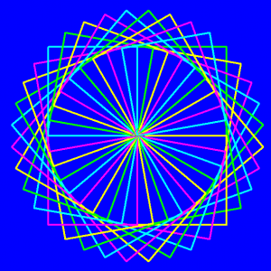
Stage 21: Artist: Patterns
http://www.tbsrj.com.br/blog/

Slide 2
Objectives
Students will:
Count the number of times an action should be repeated and represent it as a loop
Divide the number of degrees in a circle into even segments
Given a number of segments, calculate the degrees need to complete a circle
Break complex tasks into smaller repeatable sections
Combine simple shapes into complex designs with nested loops
Compose complex patterns from multiple nested loops

Slide 3
Example
Notes:
for (var count = 0; count < 4; count++) { }

Slide 4
Example
Notes:
for (var count = 0; count < 3; count++) { moveForward(50); turnRight(120); moveForward(50); turnRight(60); }

Slide 5
Directions
Complete Stage 21: Artist: Patterns
Progress your way through the stage

